Slide 1




MECHATRONICS
EDS Technology Overview
AIAA Caltech Student Branch – 18/11/20
Preliminary Design Review – H.O.M.E.S.
Header 1
Header 2
Header 3
Body
Note

Slide 2
MECHATRONICS
EDS Technology Overview
AIAA Caltech Student Branch – 18/11/20
Preliminary Design Review – H.O.M.E.S.
Header 1
Header 2
Header 3
Body
Note

Slide 3
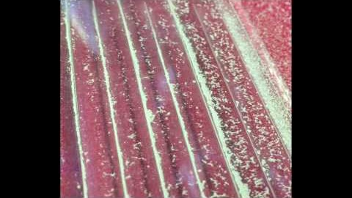
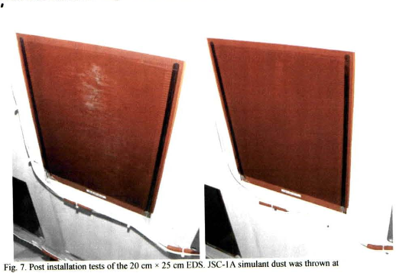
EDS OVERVIEW
Design Heritage
AIAA Caltech Student Branch – 18/11/20
Preliminary Design Review – H.O.M.E.S.
Electrodynamic Dust Shielding
Parent technology developed in 1970s
Lifts and transports charged and uncharged particles using electrostatic and dielectrophoretic forces
Works best for particle size regimes of 5-300 µm (encompasses size regime for lunar dust particles)
Technology currently being used in:
Solar panel maintenance (dust removal efficiency of 90%)
Tested in mock lunar environments
In-Situ Experiments on ISS on thermal radiators and solar panels
Ongoing; showed that EDS works in vacuum
Solar panel effectiveness 22.5%→98.4% after EDS implementation with lunar simulant
Demonstration of EDS on a glass plate; particle size < 20 µm (Guo, 2018)
EDS System mounted on sim. Lunar habitat
25 cm

Slide 4
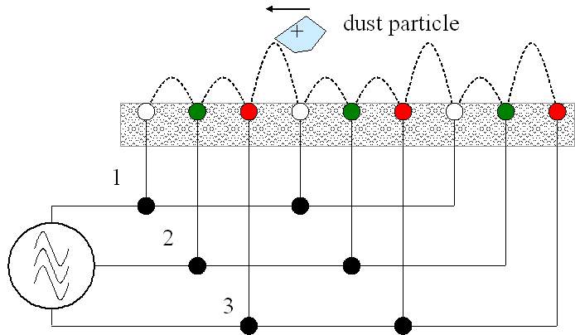
EDS OVERVIEW
How it works: interdigitated capacitor
AIAA Caltech Student Branch – 18/11/20
Preliminary Design Review – H.O.M.E.S.
Field Lines
Electrodes
+
-
Dielectric
+
-
Fringing electric field exerts force on charged dust particles
3 phased EDS Systems transport dust particles
(Calle, 2010)

Slide 5
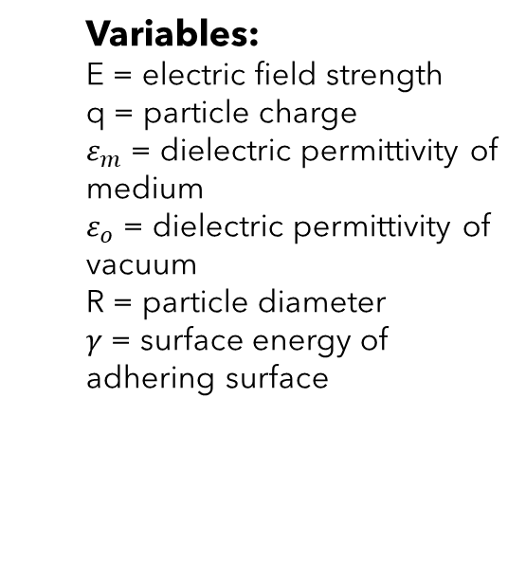
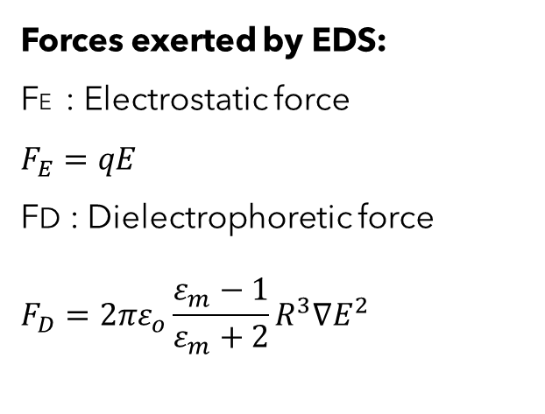
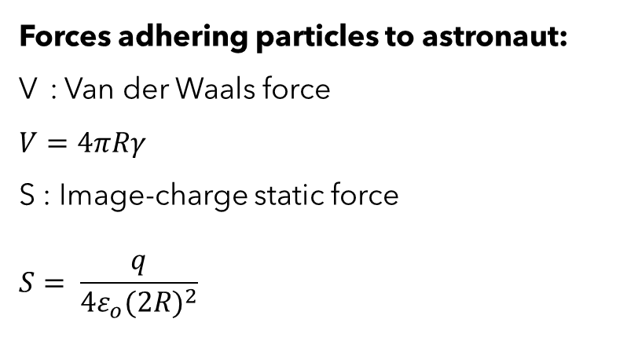
MECHATRONICS
How it works: Forces Involved
AIAA Caltech Student Branch – 18/11/20
Preliminary Design Review – H.O.M.E.S.
FE + FD
+
-
Variables:
E = electric field strength
q = particle charge
$ε_{m}$ = dielectric permittivity of medium
$ε_{o}$ = dielectric permittivity of vacuum
R = particle diameter
$γ$ = surface energy of adhering surface
Forces exerted by EDS:
FE : Electrostatic force
$$F_{E}=qE$$
FD : Dielectrophoretic force
$$F_{D}=2πε_{o}\frac{ε_{m}−1}{ε_{m}+2}R^{3}∇E^{2}$$
Forces adhering particles to astronaut:
V : Van der Waals force
$$V=4πRγ$$
S : Image-charge static force
$$S= \frac{q}{4ε_{o}{(2R)}^{2}}$$
>

Slide 6
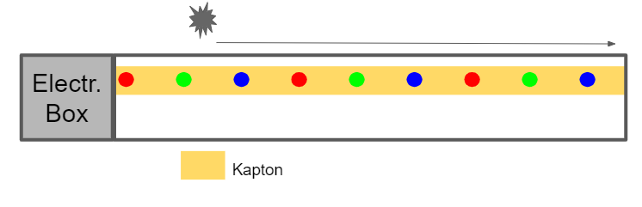
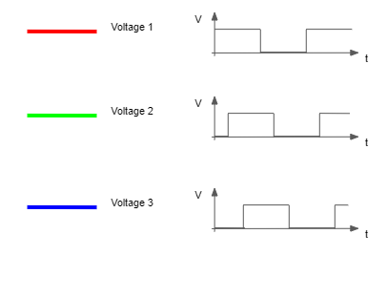
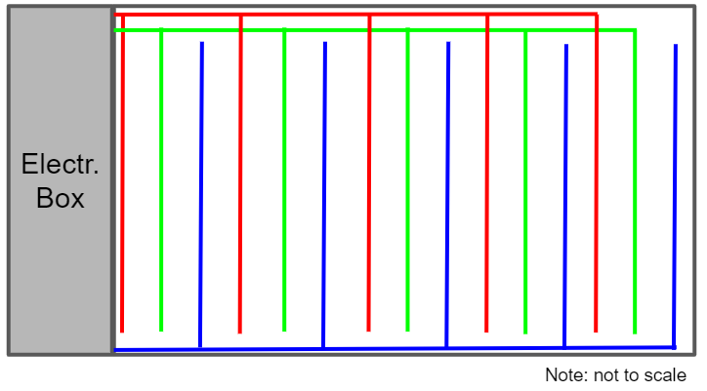
MECHATRONICS
Electrode Layout and 3-Phasing
AIAA Caltech Student Branch – 18/11/20
Preliminary Design Review – H.O.M.E.S.
Side View:
26 Gauge Copper Wires
Top View:
Electronics box made of aluminum and Multi-Layer Insulation (MLI) to protect against thermal and radiative environment
Kapton dielectric rated for -268 ̊C to 399 ̊C

Slide 7
MECHATRONICS
Controls and Operational Modes
AIAA Caltech Student Branch – 18/11/20
Preliminary Design Review – H.O.M.E.S.

Slide 8
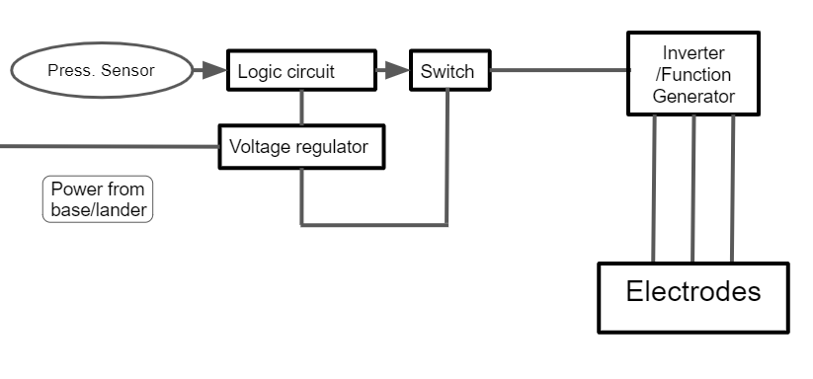
MECHATRONICS
Circuit Diagram
AIAA Caltech Student Branch – 18/11/20
Preliminary Design Review – H.O.M.E.S.
Embedded in mat
Components contained in electronics box
Embedded in mat
Sensors and components to be selected/designed from existing NASA satellite and spacecraft payloads.

Slide 9
MECHATRONICS
Power and Voltage Requirements
AIAA Caltech Student Branch – 18/11/20
Preliminary Design Review – H.O.M.E.S.
Estimates based on finite difference time domain electrostatic simulation
Obtained mesh grid of electric field strength given electrode lay-out and voltage supply
Determined electromagnetic field strength necessary to overcome adhesive forces
Current estimates predict EASE will have low power requirements
Operational Mode | Time Estimate | Voltage (DC) | Power Requirements (W)
ASTRONAUT | 3 min/astronaut | 28 V
STANDBY | VARIABLE | 28 V | <100 mW

